Slide 1
IBM University Engagement Project Submission
“Exploring the Power of Agentic AI with IBM Granite and IBM Bob”

Slide 2
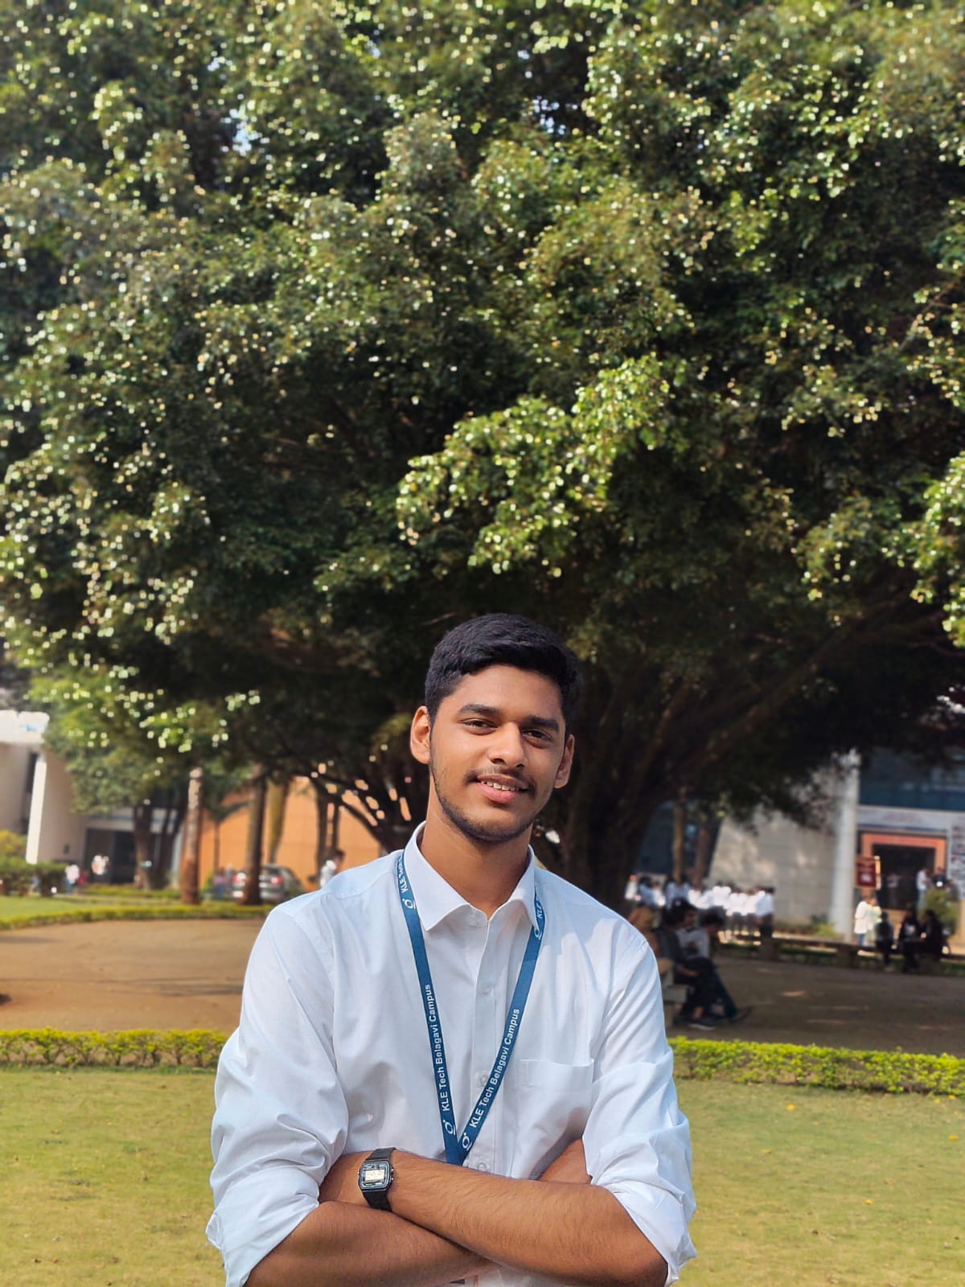
Project Tile – [NutriAgent]
Domain of Project – [Healthcare]
Student Name | Recent Passport Photo | Email ID | Mobile number [WhatsApp]
Darshan Chikorde |  | darshanchikorde20@gmail.com | 8618473375

Slide 3
Problem Statement -
Problem Statement : Nutrition Agent
The Challenge
Good nutrition is the foundation of health, but individuals often struggle with diet planning, portion control, and tracking nutritional intake. Information about healthy diets, disease-specific nutrition, and food composition is scattered across unreliable sources. Without personalized, real-time guidance, many fail to maintain balanced diets or make informed food choices.
The Objective
Build an AI-powered Nutrition Agent that delivers personalized dietary insights and guidance for individuals, families, and health professionals. The solution should:
Personalized Diet Plans – Recommend meals based on age, health conditions, allergies, cultural preferences, and fitness goals.
Food Data RAG Retrieval – Fetch and summarize nutritional values (calories, macros, vitamins) from reliable sources.
Diet Tracking & Feedback – Allow users to log meals via text, images, or voice, and provide instant nutritional analysis.
Preventive Health Focus – Suggest diets for chronic disease management (e.g., diabetes-friendly or heart-healthy plans).
Multi-Agent System –
Nutrition Knowledge Agent (fetches nutritional data)
Diet Recommendation Agent (personalized meal plans)
Health Advisory Agent (preventive health suggestions)
Food Log & Feedback Agent (meal tracking + analysis)
Visualization Dashboard – Show daily/weekly nutrient intake, deficiencies, and progress toward health goals.

Slide 4
Proposed Solution -
Proposed Solution: AI-Powered Nutrition Agent
NutriAgent is a Multi-Agent Generative AI platform using IBM Bob, IBM watsonx.ai, and IBM Granite Models to deliver personalized nutrition guidance.
RAG + Vector Database + Embeddings
Retrieves grounded nutrition knowledge for accurate food and dietary insights.
4 Specialized AI Agents:
Nutrition Knowledge → food & nutrient retrieval
Diet Recommendation → personalized meal plans
Health Advisory → preventive & disease-specific guidance
Food Log & Feedback → text/image/voice meal analysis
Key Features:
Personalized Diet Plans • Multimodal Meal Logging • Nutrition Analysis • Calorie & Macro Tracking • Health Goals • Deficiency Insights • AI Chat • Interactive Dashboard
IBM Integration:
IBM Bob – Agent orchestration | watsonx.ai – AI platform | Granite – Reasoning & Generation
Outcome: Real-time, personalized, grounded and actionable nutrition insights.

Slide 5
Technology Used
IBM Bob platform -For designing and orchestrating multi-agent workflows visually
IBM Grainte model - for eg – ibm-granite-3-2-8b – For natural language understanding, reasoning, and personalization
IBM Cloud – It provides the infrastructure to build, deploy, and scale the Nutrition Agent efficiently. IBM Cloud enables a reliable, secure, and scalable environment for deploying the Nutrition Agent.
RAG– RAG to fetch real data first, then generate intelligent answers, making the Nutrition Agent more trustworthy and effective.
IBM Watsonx.ai - For model deployment, embeddings, and AI governance
Vector Database (FAISS/Chroma) – For RAG-based nutritional data retrieval

Slide 6
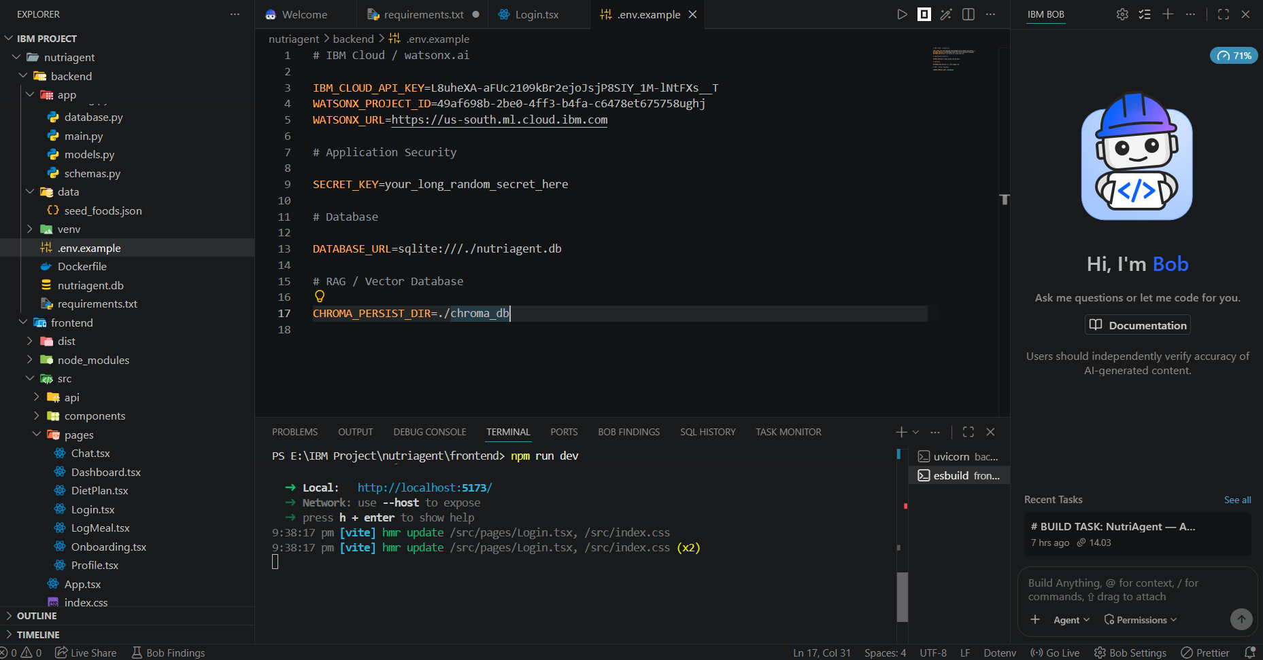
Required Files created using IBM bob -
Main.py
Requirements.txt
Style.css
.env
Index.html

Slide 7
IBM Bob Screenshots:

Slide 8
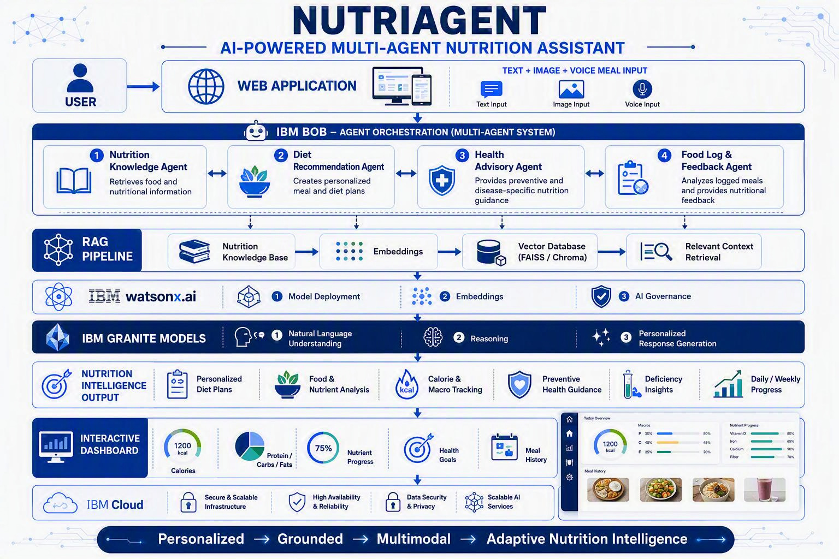
Architecture blueprint for IBM bob:

Slide 9

Role of Agentic AI in the solution
Role of Agentic AI in Nutrition Agent
Autonomous Decision-Making: IBM watsonx.ai + Granite coordinate nutrition tasks beyond basic chatbot responses.
Multi-Agent Collaboration: Specialized agents handle nutrition retrieval, diet planning, health advisory, and food-log analysis.
Context Awareness: Considers age, health conditions, allergies, preferences, and fitness goals.
Real-Time Adaptation: Updates recommendations based on daily meals and user feedback.
Agent Communication: Agents collaborate to improve decision-making and task execution.
Goal-Driven Guidance: Delivers personalized, proactive, and actionable nutrition recommendations.
Outcome: A smart digital nutritionist providing personalized, context-aware, and adaptive health guidance.

Slide 10
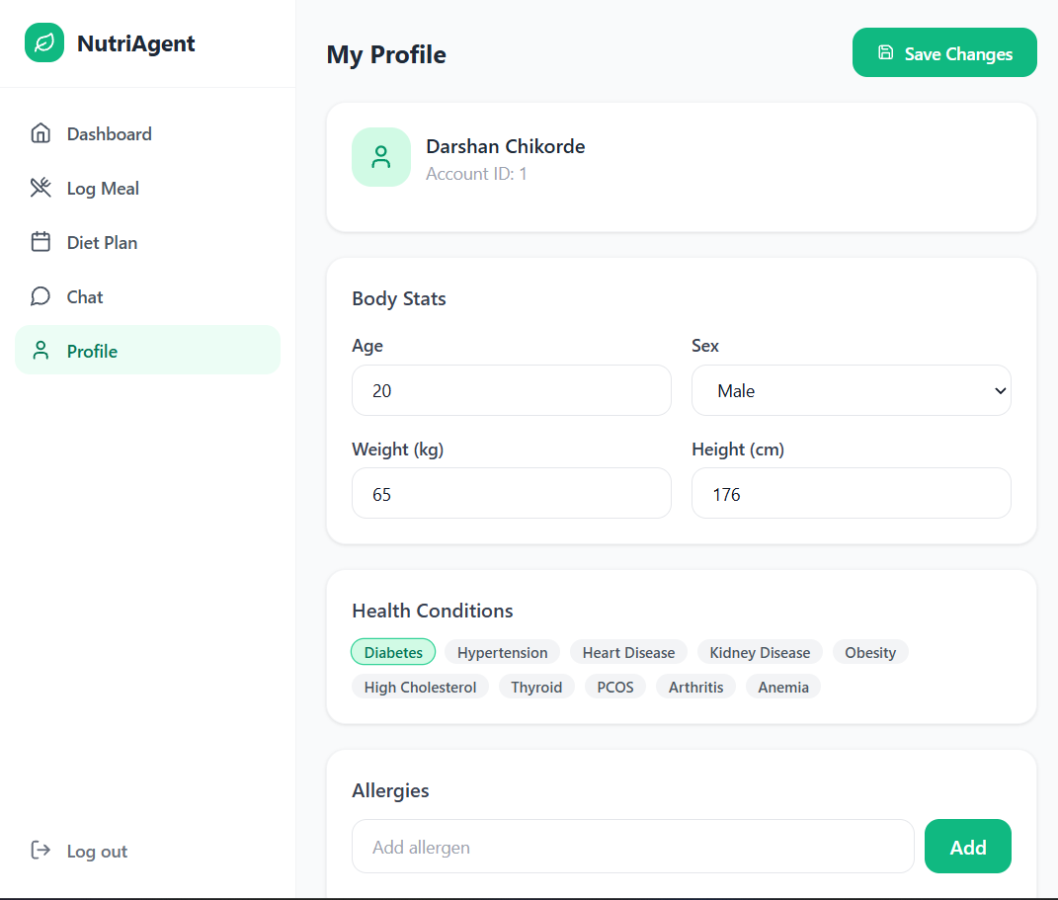
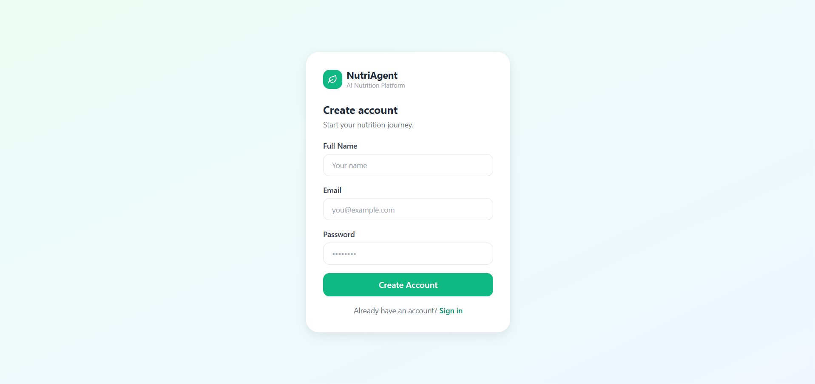
Project Output Screenshot
Please put IBM Bob output screenshots with 2-3 prompts.
You can take 2-3 more slides for each screenshot
·
·
·

Slide 11
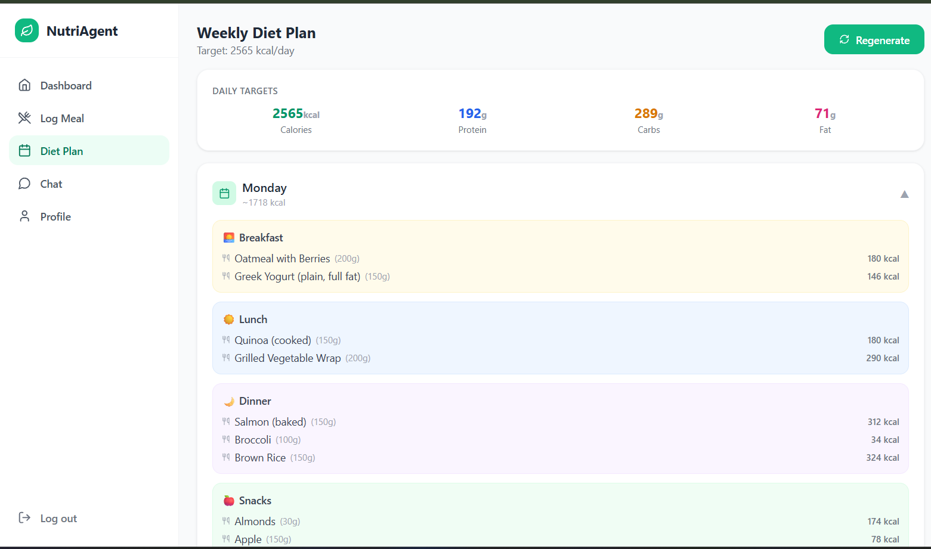
Project Output Screenshot
Please put IBM Bob output screenshots with 2-3 prompts.
You can take 2-3 more slides for each screenshot
·
·
·

Slide 12
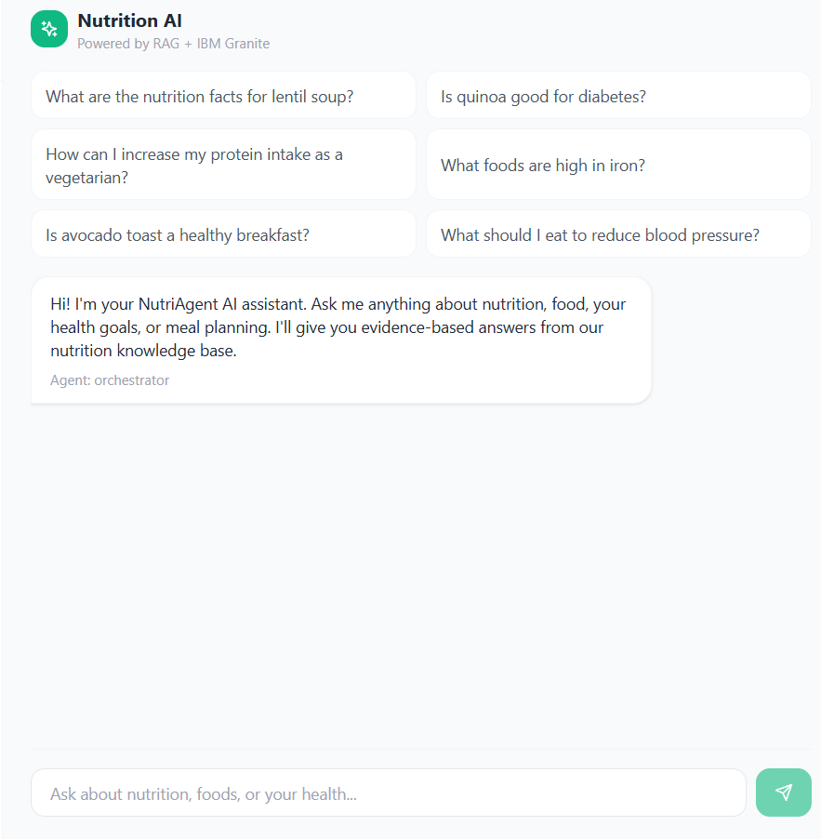
Project Output Screenshot
Please put IBM Bob output screenshots with 2-3 prompts.
You can take 2-3 more slides for each screenshot
·
·
·

Slide 13
Novelty and Uniqueness
Novelty & Uniqueness
Multi-Agent Nutrition System – Specialized AI agents collaborate instead of relying on a single chatbot.
RAG-Grounded Responses – Retrieves nutrition data before generating recommendations, reducing unsupported answers.
Multimodal Food Logging – Accepts Text, Image & Voice for convenient meal tracking.
Personalized & Context-Aware – Adapts recommendations to health conditions, allergies, preferences & fitness goals.
Continuous Feedback Loop – Uses logged meals and progress to dynamically refine recommendations.
Preventive Nutrition Focus – Combines everyday diet planning with disease-specific and health-oriented guidance.
Unique Value: An adaptive, goal-driven AI nutrition ecosystem rather than a conventional diet planner or calorie tracker.

Slide 14
Git Hub Link
· Please create public github repository (Enable Add README button while creating repository) with format –
Please test and Paste the working Github URL –
Make sure you have Uploaded following three files into your github repository
1) All Agent relevant files of IBM Cloud , 2) yourproblemstatement.pdf file 3) your projectpresntation.pptx file 4)any other files
·
·
·

Slide 15
Future Scope
Future Scope
Wearable Integration – Connect fitness bands and smartwatches for real-time activity and health data.
Advanced Personalization – Adapt plans using lifestyle, preferences, progress and long-term health goals.
Regional Food Intelligence – Expand nutrition database for Indian, regional and cultural cuisines.
Predictive Health Insights – Identify nutritional risks and trends through user history.
Voice-First Nutrition Assistant – Enable natural voice-based interaction and hands-free meal logging.
Scalable Agent Ecosystem – Add specialized agents for fitness, meal shopping, recipes and health monitoring.
Mobile & Cloud Deployment – Extend the platform for scalable, cross-device access.
Future Vision: A continuously learning AI-powered personal nutrition ecosystem integrating food, fitness and preventive health.
·
·
·

Slide 16
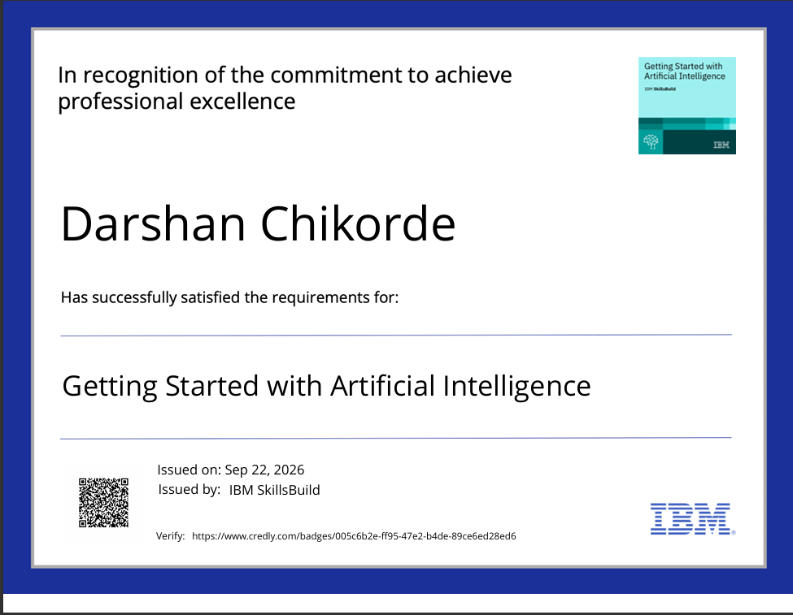
Certificates Earned:
Please add your credly certificate

Slide 17
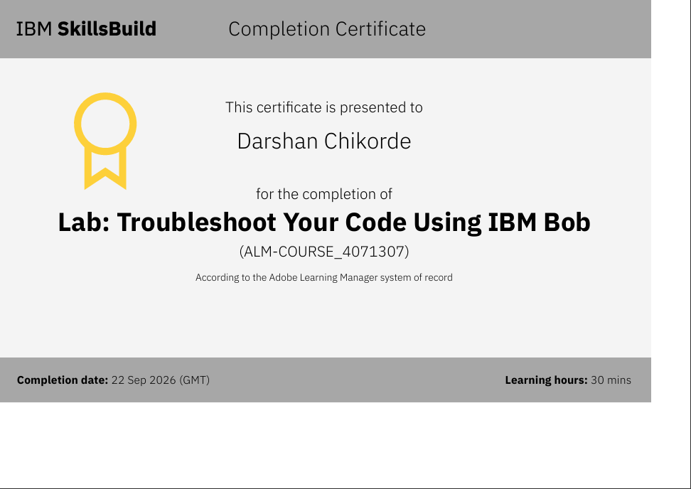
Certificates Earned:​
Add your IBM BOB Certificate

Slide 18


